Slide 1
Application based on ar and cv
MANOJ.R.D
HARI HARAN M.V

Slide 2
INDRODUCTION ON AR AND CV

Slide 3
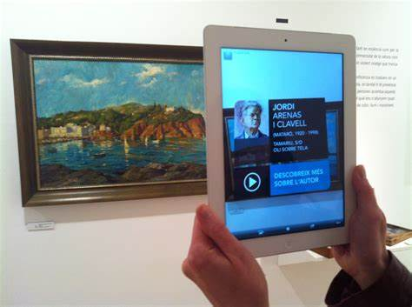
AUGMENTED REALITY (AR)
Augmented Reality (AR) is a technology that enhances the real-world environment with computer-generated perceptual information, such as images, sounds, and text. AR adds a layer of digital information onto the physical world, making it possible to interact with virtual objects as if they were real.
AR technology works by using a device such as a smartphone, tablet, or smart glasses to overlay digital information onto the real-world environment. The device uses sensors, cameras, and GPS to track the user's location and movements, and then overlays digital information onto the real-world view.

Slide 4
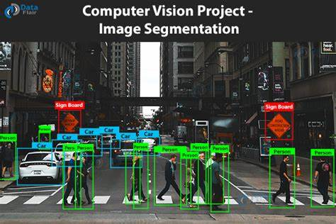
COMPUTER VISION(CV)
Computer vision is an interdisciplinary field that deals with how computers can interpret and understand images and videos from the real world. It involves the use of algorithms and mathematical models to analyze and extract information from visual data.
Computer vision has applications in various fields such as robotics, medicine, surveillance, entertainment, and transportation. Some of the common tasks that computer vision can perform include object recognition, image segmentation, tracking, 3D reconstruction, and image restoration.

Slide 5
OBJECTIVES:
The ultimate goal of AR is to enhance the user’s experience and which create an immersive experience for the user , with the help of computer vision we could able to extract the information from the image or video . By combainiong both ar and cv we could able to see the data vertualiy and extract or respond to the data . AR helps in extracting or process the image or video from the video we could able to process the frames with the help of computer vision

